Slide 1



PREDICTING ALGAE BLOOMS

Slide 2

AGENDA
OBJECTIVE
BACKGROUND STUDY
DATASET
METHODOLOGY
RESULTS AND DISCUSSION

Slide 3
OBJECTIVE
TO PREDICT THE FREQUENCIES OF THE SEVEN ALGAE FOR THE WATER SAMPLE.
TO PROVIDE A BETTER UNDERSTANDING OF THE
FACTORS INFLUENCING THE ALGAE FREQUENCIES.
REDUCING THE COST BY TRAINING THE MODEL.

Slide 4


4
FLOW CHART
ADVANCED RESEARCH
PREDICTION OF ALGAE BLOOM
Reasons for algal bloom.
A review of existing literature related to the prediction of algal blooms.
Data unification and missing value interpolation with the data.
Tide generation and selection of associated variables.
Build predictive models.
Water Samples data

Slide 5
ADVANCED RESEARCH
Research paper review 1
Use of ML methods to build a decision support system for predicting the distribution of coastal ocean algal blooms based on remote sensing data in Monterey Bay.
To solve, Random Forest model using MODIS and MERIS satellite data and compare the results with SVM.[ 1 ]
Research paper review 2
3 Deep learning models are used for prediction of chlorophyll-a,
Multilayer perceptron (MLP)
Recurrent neural network (RNN)
Long short-term memory, LSTM
Results were compared with those from OLS (ordinary least square) regression analysis and actual data based on the RSME. [ 2 ]

Slide 6


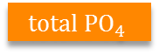




DATASET
30% TESTING SET (60)
70% TRAINING SET (140)
200 OBSERVATION
CATEGORICAL VARIABLES
SEASON
SIZE
SEASON
CHEMICALS IN THE WATER
pH
$$O_{2}$$
Cl
$${NO}_{3}$$
$${NH}_{4}$$
$${PO}_{4}$$
$${total PO}_{4}$$
Chla
a1
a2
a3
a4
a5
a6
a7
FREQUENCIES OF ALGAE

Slide 7

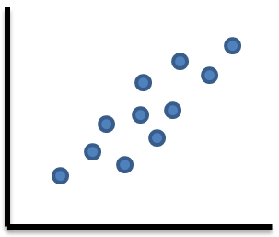
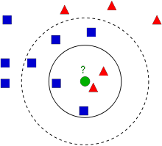
METHODOLOGY
DATA CLEANING
Ignoring all the cases are not complete
Filtering the data with atleast 0.2% NA values and then storing the median in the place of NA values
Filtering the data with atleast 0.2% NA values and then performing Central Imputation
Using correlation and linear model.
Using Knn Imputation with k=10

Slide 8
METHODOLOGY
SELECTION OF MODEL
1
2
3
4
5
Performing and improvising linear model for algae type 1 prediction
Performing and pruning regression trees algorithm for algae type 1 prediction
Calculating the errors of both the models and plotting the graph
We identify the bad predictions
Removing the negative values to improvise the performance

Slide 9
METHODOLOGY
K FOLD CROSS VALIDATION
K IS THE NUMBER OF ROWS FOR TRAINING (RANDOMLY SELECTED)
10 ROWS PERFORM LINEAR MODEL, RANDOM FOREST, REGRESSION TREE
BASED ON NORMALIZED LMSE VALUE SELECT THE BEST MODEL SUITABLE FOR THAT TYPE OF ALGAE.

Slide 10
METHODOLOGY
MODELS

Slide 11
REFERENCES
[1] Lee, Sangmok, and Donghyun Lee. "Improved Prediction of Harmful Algal Blooms in Four Major South Korea’s Rivers Using Deep Learning Models." International journal of environmental research and public health 15, no. 7 (2018): 1322.
[2] Song, W., Dolan, J.M., Cline, D. and Xiong, G., 2015. Learning-based algal bloom event recognition for oceanographic decision support system using remote sensing data. Remote Sensing, 7(10), pp.13564-13585.

Slide 12
THANK YOU

Slide 13
SlidesCarnival icons are editable shapes.
This means that you can:
Resize them without losing quality.
Change line color, width and style.
Isn’t that nice? :)
Examples:

Slide 14
😉
Now you can use any emoji as an icon!
And of course it resizes without losing quality and you can change the color.
How? Follow Google instructions https://twitter.com/googledocs/status/730087240156643328
✋👆👉👍👤👦👧👨👩👪💃🏃💑❤😂😉😋😒😭👶😸🐟🍒🍔💣📌📖🔨🎃🎈🎨🏈🏰🌏🔌🔑 and many more...

